Slide 1
Drawing Forces

Slide 2
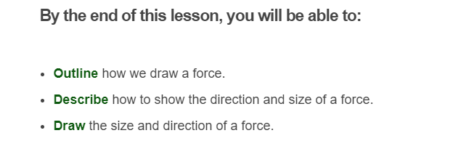

Slide 3
Have you ever seen a force?
Forces are invisible, and we can only feel their effects!
So how can we draw a force?

Slide 4

How can we draw a force?
We can represent a force by drawing an arrow, like this:
The arrow tells us which way the force is applied. This means it shows us the direction the force acts in.
The size of the arrow shows us how big the force is. The bigger the arrow, the bigger the force.

Slide 5
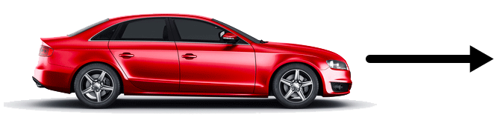
Lets look at an example.
The arrow below shows the direction of the force acting on a car.
This force is called thrust - it is the force of the car's engine that moves it forward.

